Slide 1
Overview of Taxes
Unit 1

Slide 2

Pre course questionnaire
Please complete the pre course questionnaire via the following link:
https://www.surveymonkey.com/r/PVPCQLW

Slide 3

Learning Intentions
At the end of the unit, I will be able to:
1 | Explain the term taxation and outline the purpose of a tax system
2 | Understand the reasons for paying taxes
3 | Outline the types of taxes collected by the Revenue Commissioners from individuals and businesses
4 | Identify the main areas of government income (revenue) and expenditure

Slide 4

What is taxation?
Activity 1

Slide 5
Taxation Definition
Activity 1

Slide 6



What is the purpose of taxation?
Activity 2

Slide 7




Principles of Taxation
Fairness
Certainty
Efficiency
Convenience

Slide 8
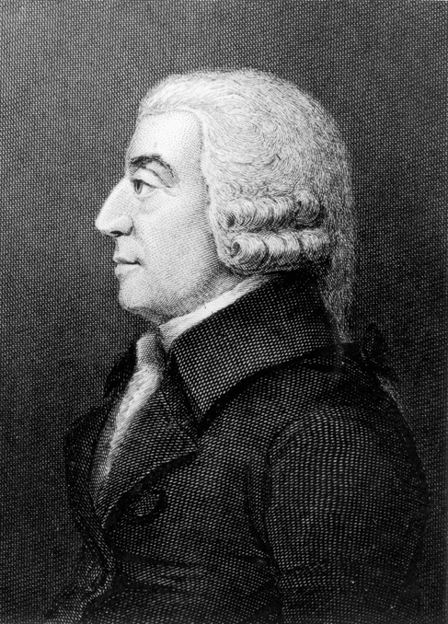
Principles of Taxation 2
Principles of Taxation
Fairness
Taxes levied should be based on a person’s / firm’s ability to pay
Certainty
People should know how much tax they have to pay, when the tax must be paid and how the tax will be collected
Adam Smith 1723-1790 Scottish Philosopher & Economist. Author of “…The Wealth of Nations”
Notes:
https://quickonomics.com/the-four-canons-of-taxation/

Slide 9
Principles of Taxation
3
Principles of Taxation
Convenience
There should be a simple process to
pay and collect taxes owed
Efficiency
The cost to collect taxes should be kept to a minimum
Adam Smith 1723-1790 Scottish Philosopher & Economist. Author of “…The Wealth of Nations”
Notes:
https://quickonomics.com/the-four-canons-of-taxation/

Slide 10
Tax Collection
Who collects taxes
on behalf of the
government in Ireland?

Slide 11
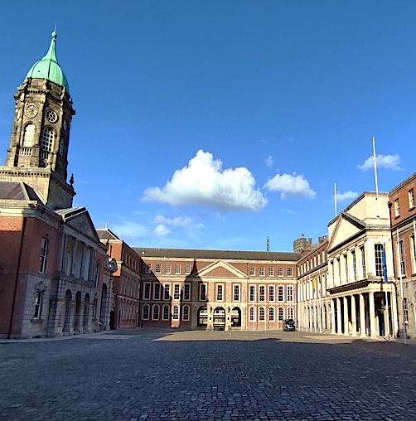
Revenue Commissioners
In 1922, Michael Collins
(Minister for Finance in the Provisional Government) made the decision that led to the establishment of the Office of the Revenue Commissioners in 1923.
  It combined the two parts of the existing British Tax and Customs Administration to form Revenue
Since 1923 the headquarters
have been based at Dublin Castle
Notes:
Image from Revenue Centenary Exhibition

Slide 12

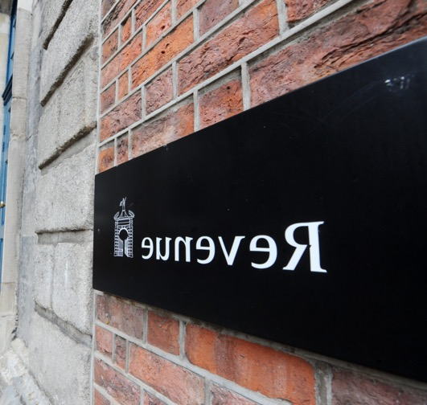


Revenue Commissioners at a Glance
Over
7,000 staff
Over 29 Revenue
Offices in Ireland
61% of staff
are female
Over 39,542 staff training days p.a.
Notes:
Figures from Revenue Annual Report 2023

Slide 13
Revenue Commissioners Mission Statement
Our Mission
To serve the community
by fairly and efficiently collecting taxes and duties and implementing
customs controls

Slide 14
Revenue Commissioners Statement of Strategy 2023 - 2025
Our Vision
To be a leading tax
and customs administration, trusted
by the community,
and an employer
of choice
Service for Compliance
Confront Non- Compliance
Notes:
Similar diagram to the diagram used in: https://www.revenue.ie/en/corporate/documents/governance/sos-2021-2023.pdf

Slide 15


Identify sources of income for the Irish government
Activity 3
Taxation
Other Sources

Slide 16
Government Income from Taxation
Income Tax
Value Added Tax (VAT)
A tax on an employee’s income
The current rates are 20% and 40%
A tax charged on goods and services paid by the end consumer
Customs Duty
Universal Social Charge (USC)
A tax paid on goods and services purchased from outside the European Union
A tax on an employee’s income

Slide 17
Government Income from Taxation 2
Government Income from Taxation
Excise Duty
Capital Acquisitions Tax (CAT)
A tax used to discourage consumption and is paid on mineral oils (petrol, diesel, kerosene), tobacco products and alcohol
A tax charged on a gift or an inheritance
Capital Gains Tax (CGT)
A tax paid on the profit made on the sale of an asset
Deposit Interest Retention Tax (DIRT)
A tax paid on interest earned on savings

Slide 18
Government Income from Taxation 3
Government Income from Taxation
Local Property Tax (LPT)
Stamp Duty
A self-assessed tax based on the market value of residential property in Ireland
A tax paid on the written documents that transfer ownership of land and buildings
It is also a tax on cardholders on financial cards, charge cards and credit cards
Vehicle Registration Tax (VRT)
A tax paid when registering a new vehicle and vehicles imported to Ireland
Corporation Tax
A tax paid on company profits

Slide 19
Government Income 2023
Activity 3

Slide 20

On what does the government spend its income?
Activity 4

Slide 21









On what does the government spend its income?
Activity 5
In 2024 government expenditure is expected to be €110.1 billion. Working in pairs / groups use a ranking ladder to rank the areas of expenditure shown below, from the most to least important. Discuss the reasons for your ranking decisions. Once you have done this, decide how much money you will allocate to each area.
1.
2.
3.
4.
5.
6.
7.
8.
Social Protection
Health
Education
Justice
Housing
Debt Servicing
& EU Payments
Transport
Other – Government
Department
Expenditure

Slide 22
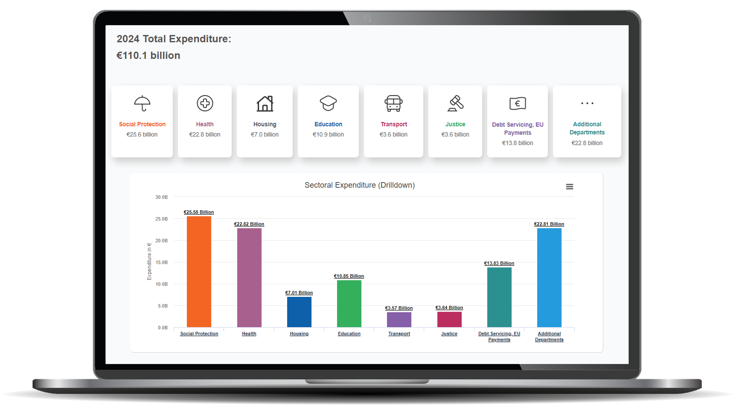
Website
Website

Slide 23

Government Expenditure
Activity 5
Why did you allocate money
in this way?
Did your allocations differ from the government allocations?
Were
there any disagreements about the allocation?
Were
there any government allocations that surprised you?

Slide 24

Government Expenditure
Activity 5
What public services would you be prepared to give up if you could pay less tax?
What impact could these tax cuts have?

Slide 25

Unit 1- Overview of Taxes
Activity 6
local property tax
vehicle registration tax
taxation
capital gains tax
Universal Social charge
excise duty
corporation tax
stamp duty
Government expenditure
value added tax
carbon tax
government revenue
capital acquisition tax
income tax
sugar sweetened drinks tax
deposit interest retention tax

Slide 26

Learning Journal
Complete
your Learning
Journal for
Unit 1
- Overview
of Taxes

