Slide 1
Income Tax for Employees
Unit 3

Slide 2

Learning Intentions
At the end of the unit, I will be able to:
1 | Explain the different types of income earned by individuals and businesses
2 | Differentiate between direct and indirect taxes
3 | Distinguish between taxable and non-taxable income
4 | Outline the concept of tax rate bands and tax credits
5 | Explain how the PAYE system operates
6 | Complete basic Income Tax calculations
2

Slide 3

Unit 2 – Retrieval Practice
Activity 1
Fill in the brain dump table below with as much information as you can remember from Unit 2 – How Taxes are Made.
Sin and Pigouvian Taxes
Dáil Éireann and Seanad Éireann
Stakeholders that influence tax laws in Ireland
Stages of a Bill
3

Slide 4

What is income? Who receives income?
Activity 2 (i)

Slide 5
What is income? Who receives income? 2
Activity 2 (i)
What is income? Who receives income?
Income is money earned from doing work
Income is a company’s profits for a particular period of time
Income is received from investments
5

Slide 6




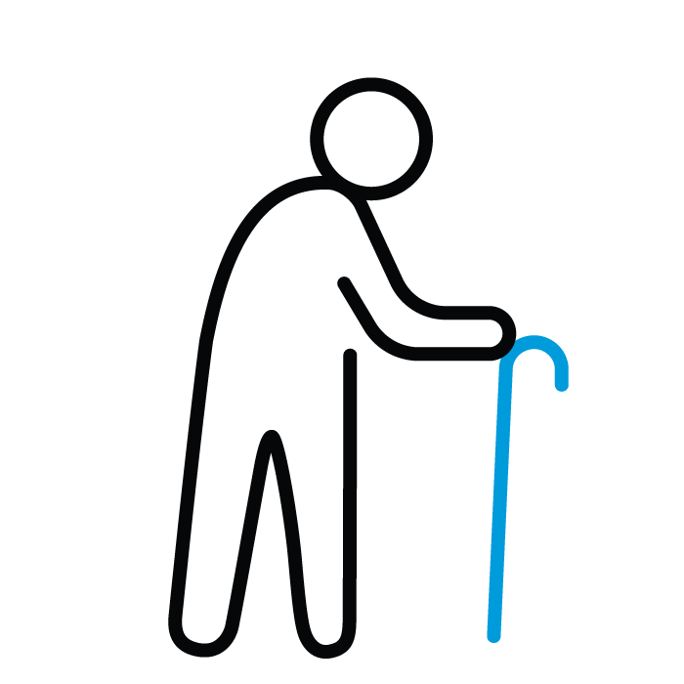

Who receives income?
Activity 2 (i)
Employees
Business Owners
Unemployed People
Students
Retirees
Government

Slide 7
What types of income can be received by individuals and businesses?
Activity 2 (ii)

Slide 8
Types of Income
Wage
Bonus
An amount of money paid to a worker based on the number of hours or days worked. It can also be earned on a piecework basis.
This is an extra payment received by an employee for reaching a target or achieving work of a high standard.
Commission
Salary
A payment received by an employee based on the value of goods / services sold. It is often paid to sales staff.
This is a fixed regular payment paid to an employee for working. Payment is often received on a monthly basis.

Slide 9
Types of Income 2
Types of Income
Tips
Rental Income
Payment given by consumers to service staff in gratitude for the level of service received, e.g. in a restaurant.
Income received by renting property to tenants, e.g. commercial and residential property.
Profit
Dividend
Received by business owners when the total revenue (sales) of their firm is greater than total costs.
Shareholders (part-owners) in a business receive a share of the firm’s profit.

Slide 10
Types of Income 3
Types of Income
Maternity Benefit
Jobseeker’s Benefit
This is a payment received
by employed, pregnant women to provide financial support while they are on maternity leave.
A weekly payment for an unemployed person and is provided by the Department of Social Protection.
Child Benefit
Pension
A monthly payment received by parents/guardians for children up to the age of 18 years in full-time education.
A regular payment made to people who have retired from work.
10

Slide 11
Direct and Indirect Taxes
Taxes can be categorised into direct and indirect taxes
Direct Taxes
This is a tax paid on income and gains, and includes:
  Income Tax
  Universal Social Charge (USC)
  Capital Gains Tax (CGT)
  Capital Acquisitions Tax (CAT)
  Deposit Interest Retention Tax (DIRT).
Indirect Taxes
This is a tax paid on goods and services and includes:
  Value Added Tax (VAT)
  Vehicle Registration Tax (VRT)
  Customs Duty
  Excise Duty
  Stamp Duty.

Slide 12
What is Income Tax?
This is a direct tax that is levied by the Irish government on income earned in the State.
Income can be categorised as:
Taxable Income
Non-Taxable
Income

Slide 13
Taxable Income
Income Tax is charged on many different types of income.
This income is known as taxable income.
The types of taxable income are categorised into different schedules.
Each schedule has different taxation rules.
Schedule D | Business Income
Schedule E | Employment Income
Schedule F | Dividend Income

Slide 14
Taxable Income
Business Income
Profits
Rental income
Employment Income
Salary, Wages
Pension
Certain Social Welfare Benefits
Jobseeker’s Benefit
Dividend Income
Share of company profits
Schedule D
Schedule F
Schedule E

Slide 15




Examples of Non-Taxable Income
Certain social
welfare benefits
Child Benefit
Lottery
Winnings
Income from Scholarships
Prize Bond Winnings
Jobseeker’s Allowance

Slide 16

Non-taxable income activity
Activity 3
What is the weekly payment for Jobseeker’s Allowance?
What is the monthly payment for Child Benefit for one child?
What is the maximum payment that can be earned in the Prize Bonds weekly draw?
What has been the largest EuroMillions lottery win in Ireland?

Slide 17




Taxable or Non-Taxable Income
Activity 4
1
I am retired and receive a work pension of €41,000 p.a.
2
I just won €1m in the national lottery.
3
4
I’m a student and have a scholarship.
My business made €100,000 profit this year.

Slide 18




Taxable or Non-Taxable Income 2
Activity 4
Taxable or Non-Taxable Income
5
I earn €700 per week from my job.
6
I receive €280 per month in Child Benefit.
7
8
I receive Jobseeker’s Benefit as I’m unemployed.
I received €10,000 dividend.

Slide 19
Income Tax Collection Methods
Income Tax is collected using two systems:
  the PAYE system
  the Self-Assessment system.
In this lesson we will focus on Income Tax on employment income (Schedule E).
Employment income is collected through the PAYE system.
Wages
Salary
Commission
Bonus
Tips
Work Pension
Maternity Benefit
Jobseeker’s Benefit
State Pension

Slide 20

Registering on the PAYE System for Your First Job
I’m Lucy. I’m in Transition Year and have just got my first job. I will be working in a local supermarket. I’m paid €9.50 per hour and plan to save some money to pay for driving lessons.
I know that I have to get set up on the PAYE system but I’m not sure what I need to do.

Slide 21
Registering on the PAYE System for Your First Job
1
2
3
4
5
If you don’t already have a PPSN*, apply at www.mywelfare.ie
Register with the Revenue Commissioners using the myAccount section on www.revenue.ie
Revenue sends a Revenue Payroll Notification (RPN) to your employer. This tells your employer how to calculate your tax.
The employer calculates Income Tax, USC†, PRSI‡, and deducts them from the employee’s pay. These deductions are sent to Revenue.
The employee receives their payslip showing income earned less any Income Tax, USC, and PRSI deductions paid to the Revenue Commissioners.
Employee
Employee
Revenue
Commissioners
Employer
Employee
*A Personal Public Service Number (PPSN) is a unique reference number that is needed to access social welfare benefits and public services.
†USC = Universal Social Charge
‡ PRSI = Pay Related Social Insurance

Slide 22
Updating the PAYE System when Changing Jobs
After working in the supermarket during Transition Year, I’ve decided to take up a new job in a local restaurant for the summer. The wages will be higher than at the supermarket and I’m hoping to earn overtime too.
Now I need to figure out how to let the PAYE system know that I’ve changed jobs.

Slide 23
Updating the PAYE System when Changing Jobs
1
2
3
4
5
Give your PPSN to the new employer.
The employer notifies the Revenue Commissioners that you are working for a new employer.
Revenue sends a Revenue Payroll Notification (RPN) to your new employer. This tells your new employer how to calculate your tax.
The employer calculates the Income Tax, USC and PRSI and deducts them from the employee’s pay. These deductions are sent to Revenue
The employee receives their payslip showing income earned less any Income Tax, USC, and PRSI deductions paid to the Revenue Commissioners.
Employee
Employer
Revenue
Commissioners
Employer
Employee

Slide 24
Reading a Payslip
I’ve just received my first payslip and I don’t understand how to read it.
What are the risks if Lucy does not understand how to read her payslip?

Slide 25
Sample Payslip for Lucy
Employee Name: Lucy Kavanagh |  | Week Number: 21 |  | Date: 26 May 2023
Pay | € | Deductions | € | €
Basic | 300.00 | Income Tax | 75.00
Overtime | 75.00 | PRSI | 15.00
 |  | USC | 4.04 | Net Pay
Gross Pay | 375.00 | Total Deductions | 94.04 | 280.96
Number of hours
worked x hourly rate
∴ 30 hours x €10
Amount received for working
more hours than the employee’s standard
working week
∴ 5 hours x €15
Total pay before
deductions
Statutory deductions
Mandatory deductions made by the employer and paid to the Revenue Commissioners
Take-home pay

Slide 26
Statutory and Non-Statutory Deductions
Statutory deductions
These are deductions that the employer by law must deduct from an employee’s pay
There are three* statutory deductions:
  Income Tax
  USC (Universal Social Charge)
  PRSI (Pay Related Social Insurance)
Non- Statutory deductions
These are deductions that the employee voluntarily asks their employer to deduct from their pay
Non-statutory deductions can include:
  Trade union subscription
  Health insurance
  Private pension payments
*Revenue, in some instances, may also instruct an employer to deduct Local Property Tax (LPT) from an employee’s pay

Slide 27
How to Calculate Income Tax in the PAYE System
When calculating Income Tax, there are three main factors to consider:
Tax
Basis
Tax Rate Band
Tax Credits

Slide 28
Tax Basis
Your taxes may be collected using one of three tax basis:
  Your job is not registered with Revenue
    or
  You haven’t given your employer your PPSN
Emergency Tax*
  Each payslip is calculated separately
  Unused credits or rate bands from a previous payslip are not carried forward
Week 1
  Your credits and rate bands are accumulated from 1 January to the current date
  This is the preferred basis
Cumulative
*Emergency tax may result in employees paying a higher amount of tax temporarily

Slide 29

Tax Rate Band
In Ireland, employees pay Income Tax on the income they earn from employment, e.g. wages, salary, bonus.
The amount of Income Tax to be paid depends on how much a person earns and their personal circumstances.
The current Income Tax rates are:
  20% - Standard Rate
  40% - Marginal Rate.
40%
Marginal
Rate
20%
Standard
Rate

Slide 30
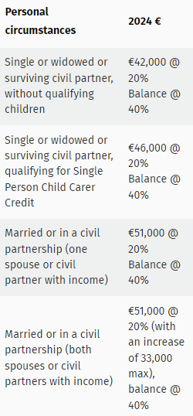
Tax Rate Band 2
Tax Rate Band
A tax rate band is the amount of income that will be taxed at a particular percentage (tax rate).
Based on the National Budget, the Revenue Commissioners publishes the current Income Tax rate bands.
These tax rate bands show people how much Income Tax they will pay on their income based on their personal circumstances.
€

Slide 31
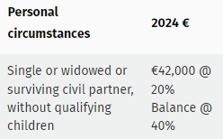
Tax Rate Bands 3
Tax Rate Band
€
Lucy works part-time in
a local restaurant.
She is single and this year earned €10,000.
By examining the tax rate band, we can see that her income is below the Standard Rate Cut-Off Point (SRCOP) of €42,000.
This means that all of her income is taxed at the standard rate of 20%.
40%
Marginal
Rate
Standard Rate
Cut-Off Point
€42,000
Lucy’s income
€10,000
20%
Standard
Rate

Slide 32

Tax Rate Bands
€
Ben works as an IT consultant
in a large multi-national firm.
He is single and this year
earned €90,000.
By examining the tax rate band, we can see that Ben will be taxed at the standard rate of 20% up to the Standard Rate Cut-Off Point (SRCOP) of €42,000.
This means that the remainder of his income, €48,000 (€90,000 - €42,000) will be taxed at the higher rate of 40%.
Ben’s remaining
income
€48,000
40%
Marginal
Rate
Standard Rate
Cut-Off Point
€42,000
Ben’s income
up to €42,000
20%
Standard
Rate

Slide 33
Tax Rate Bands
Income Tax rate bands are shown at annual rate, e.g. a single person can earn up to €42,000 per year and will be taxed at the standard rate of 20%.
How do you apply the Income Tax rate bands if you are paid weekly, fortnightly or monthly?
Let’s look at an example of a single person that earns €30,000 per year. Their Standard Rate Cut-Off Point is as follows:
 | € | € | € | €
 | Annual | Monthly | Fortnightly | Weekly
Single Person | 42,000.00 | 3,500.00 | 1,615.38 | 807.69
€42,000 ÷ 12
€42,000 ÷ 26
€42,000 ÷ 52

Slide 34
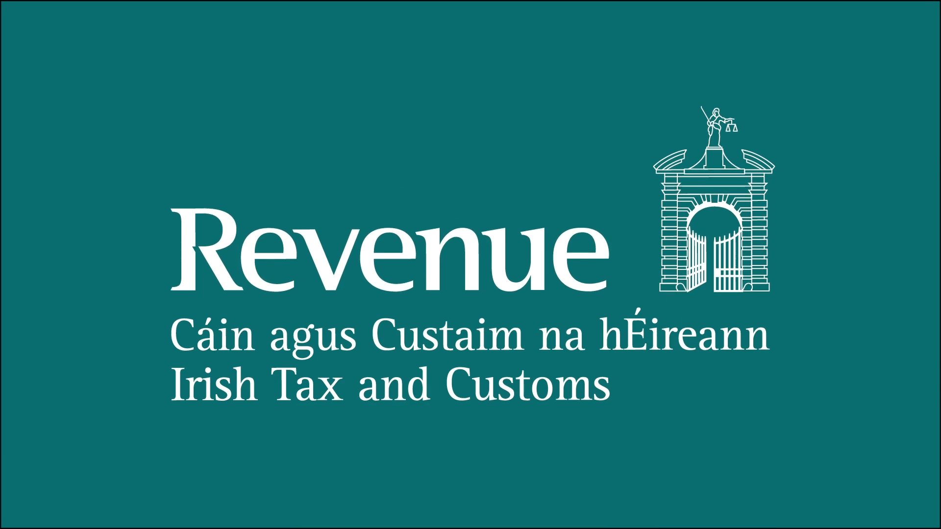
Income tax for employees video
Notes:
From 0:00 – 2:10

Slide 35
Question 1 – Gross Tax Calculation
Azfar works in an insurance company. He is single and earns €25,000 per year. Calculate his gross tax.
€
 | €
€25,000 × 20% | 5,000
Gross Tax | 5,000
As Azfar is single, he can earn up to €42,000,
which is taxed at the standard rate of 20%.
His entire income is within this band and is taxed at 20%.
The amount of Income Tax to be paid
before any deductions are made due
to personal circumstances.

Slide 36
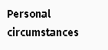

Question 2 – Gross Tax Calculation
Mia works in an IT company. She is single and earns
€50,000 per year. Calculate her gross tax.
€
 | €
€42,000 × 20% | 8,400
€8,000 × 40% | + 3,200
Gross Tax | 11,600
Mia is single and can earn up to
€42,000 that is taxed at 20%.
The remainder of her income above €42,000
is taxed at the marginal rate of 40%.
€50,000 - €42,000 = €8,000
€8,000 is taxed at 40%.

Slide 37
Question 3 – Gross Tax Calculation
Yihang works as a graphic designer. He is single and earns €660 per week on the first week of the year. Calculate his gross tax.
€
 | €
€660 × 20% | 132.00
Gross Tax | 132.00
Yihang is single and has a weekly Standard Rate Cut-Off Point (SRCOP), of €807.69 (€42,000 ÷ 52 weeks). As his weekly income of €660 is below the weekly SRCOP, all of his income is taxed at the standard rate of 20%.

Slide 38
Question 4 – Gross Tax Calculation
Kevin works in a marketing firm. He is single and earns €900
on the first week of the year. Calculate his gross tax.
€
 | €
€807.69 × 20% | 161.54
€92.31 × 40% | + 36.92
Gross Tax | 198.46
Kevin’s weekly SRCOP is €807.69
(€42,000 ÷ 52 weeks). This amount is taxed at the standard rate of 20%.
Any amount that Kevin earns above €807.69
per week is taxed at the marginal rate of 40%.
€900 - €807.69 = €92.31 is taxed at 40%.

Slide 39


Tax Credits
Tax credits reduce the amount of Income Tax a person pays
  Gross Tax – Tax Credits = Net Tax (actual amount of tax to be paid)
The amount of tax credits a person receives depends on their personal circumstances including:
Personal Status
Dependents
Age
Health

Slide 40


Tax Credits 2
Tax Credits
Tax credits are given for the entire tax year.
  Unused credits cannot be carried forward to the next tax year.
Examples of tax credits include:
Single Person
Married Person / Civil Partner (without children)
Employee PAYE Tax Credit
Widowed Person / Surviving Civil Partner*

Slide 41
Identify the Tax Credits
Activity 5
Identify the tax credits that each person is entitled to receive.
1
My name is Sam and I am single.
I live in Cork and work in a local
recruitment agency.
2
My name is Hassan and I am married and my wife is not currently working. I work in an engineering company.

Slide 42
Identify the Tax Credits 2
Activity 5
Identify the Tax Credits
Identify the tax credits that each person is entitled to receive.
3
My name is Nikolas and I am a widower. I have no children and I work in a call centre in Dublin.
4
My name is Anna and I am in a civil partnership. I have one child and my partner is currently not working. I work in a supermarket.

Slide 43
Question 1 – Net Tax Calculation
Azfar works in an insurance company. He is single and earns €25,000 per year.
His Standard Rate Cut-Off Point (SRCOP) is €42,000.
He is entitled to an Employee PAYE Tax Credit of €1,875 and a Single Person Tax Credit of €1,875.
Calculate his net tax.
 |  | €
€25,000 × 20% |  | 5,000
Gross Tax |  | 5,000
Less Tax Credits
Employee PAYE | 1,875
Single Person | + 1,875 | - 3,750
Net Tax |  | 1,250
Amount of Income Tax to be paid
after deductions have been made

Slide 44
Question 2 – Net Tax Calculation
Kevin works in marketing firm. He is single and earns €900 on the first week of the year.
His Standard Rate Cut-Off Point (SRCOP) is €42,000.
He is entitled to an Employee PAYE Tax Credit at €1,875 and a Single Person Tax Credit of €1,875.
Calculate his net tax.
 |  | €
€807.69 × 20% | 161.54
€92.31 × 40% | + 36.92
Gross Tax |  | 198.46
Less Tax Credits
Employee PAYE | 36.06
Single Person | + 36.06 | - 72.12
Net Tax |  | 126.34
€1,875 ÷ 52 weeks = €36.06 per week

Slide 45
Income tax for employees video
Notes:
From 2:10 – 5:14

Slide 46

Unit 3 – Income Tax for Employees Revision
Activity 6
rpn
commission
taxable income
tax rate band
salary
wage
emergency tax
dividend
income
child benefit
tax credit
non-statutory deduction
direct tax
overtime
paye
Indirect tax
Income tax
job seeker’s benefit
pension
statutory deduction
ppsn
Non-taxable income

Slide 47

Learning Journal
Complete your Learning
Journal for
Unit 3 –
Income Tax For Employees.

