Slide 1
USC and PRSI for Employees
Unit 4

Slide 2

Learning Intentions
At the end of the unit, I will be able to:
1 | Explain the concept of Universal Social Charge (USC)
2 | Complete basic USC calculations
3 | Differentiate between income that is subject to USC and income that is exempt from USC
4 | Examine and explain the elements of a Tax Credit Certificate (TCC)
5 | Explain the components of PRSI contributions and the benefits received from these contributions
6 | Explain how PRSI is calculated

Slide 3
Unit 1-3 Retrieval Practice
Activity 1
Answer as many questions as possible in the time allocated and total your score out of 18 marks.
List the four principles of a tax system. (3 marks) | Distinguish between VAT and CAT. (3 marks) | What do the letters DIRT mean? (3 marks)
How many stages are in a Bill? (2 marks) | Name two sin taxes in Ireland. (2 marks) | List two stakeholders that influence tax law in Ireland. (2 marks)
Name three types of income received by an employed person. (1 mark) | State the current rates of Income Tax in Ireland? (1 mark) | What do the letters PPSN mean? (1 mark)

Slide 4




PAYE System Revision
PAYE System
collects taxes
Sends taxes
collected
Sends
RPN
Employer
Calculates and deducts the
following from employees’ pay:
Income Tax, USC
PRSI, LPT*
Employees
People who receive
a work pension
*If the LPT is collected from your pay
Notes:
*If the LPT is collected from your pay

Slide 5




What is Universal Social Charge (USC)?
Introduced in 2011
Replaced the Income Levy and Health Levy
Collected through the PAYE system
Statutory deduction
Tax on income
Calculated based on details from the RPN
A person may pay:
Income Tax and USC
Income Tax or USC
Neither Income Tax nor USC

Slide 6
Universal Social Charge
USC is charged where total income exceeds €13,000.
If your income is
below €13,000 –
you do not pay USC.
Exempt from USC
Subject to USC
Wage
All social welfare payments
Salary
Scholarship income
Bonus
Prize Bond winnings
Commission

Slide 7
USC Tax Rate Bands
Rate Band | Yearly | Monthly | Weekly
Income chargeable at 0.5% | €12,012 | €1,001 | €231
Income chargeable at 2% | €13,748 | €1,145.67 | €264.39
Income chargeable at 4% | €44,284 | €3,690.34 | €851.62
Income above €70,044 is charged at 8%.
Other USC rates apply in different circumstances.

Slide 8

USC Tax Rate Bands 2
USC Tax Rate Bands
Rate Band | Yearly
Income chargeable at 0.5% | €12,012
Income chargeable at 2% | €13,748
Income chargeable at 4% | €44,284
Income chargeable at 8% | Above €70,044
All income
above €70,044
Taxed
at 8%
Next €44,284
Taxed
at 4%
Taxed
at 2%
Next €13,748
Taxed
at 0.5%
First €12,012

Slide 9

USC Reduced Tax Rate Bands
Reduced USC rates apply when a person
OR
AND
Holds a full medical card
Has annual income of <€60,000
Is ≧70 years
Rate Band | Yearly | Monthly | Weekly
Income chargeable at 0.5% | €12,012 | €1,001 | €231
All income over this amount chargeable at 2%

Slide 10
USC Calculation 1
Sorcha is 28 years old and works in an engineering firm. She earns €50,000 per year. Calculate her annual USC payable.
 | €
First €12,012 x 0.5% | 60.06
Next €13,748 x 2% | 274.96
Balance €24,240 x 4% | + 969.60
Total | 1,304.62

Slide 11
USC Calculation 2
Haytham is 42 years old and works in a science research firm. He earns €80,000 per year. Calculate his annual USC payable.
 | €
First €12,012 x 0.5% | 60.06
Next €13,748 x 2% | 274.96
Next €44,284 x 4% | 1,771.36
Balance €9,956 x 8% | + 796.48
Total | 2,902.86

Slide 12
USC Calculation 3
Theo is 52 years old and earns €800 per week. He is paid on the first week of the year. Calculate his USC payable.
 | €
First €231 x 0.5% | 1.16
Next €264.39 x 2% | 5.29
Balance €304.61 x 4% | + 12.18
Total | 18.63

Slide 13
Tax Credit Certificate (TCC)
When you register your job with the Revenue Commissioners,
you are sent a Tax Credit Certificate (TCC).
The Tax Credit Certificate lists your:
  Tax credits and rate band
  USC rates and rate band
  Employment identifier (a unique reference set by your employer
  for your employment).
Revenue issues a TCC to employees in December for the year ahead.
An employee receives an amended TCC if their circumstances
change during the year.

Slide 14
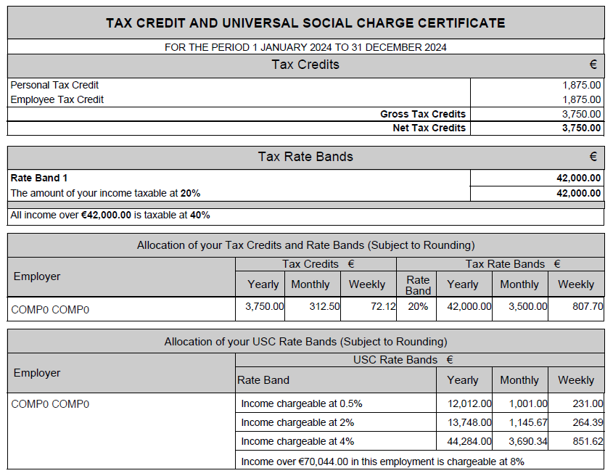
Tax credit and universal social charge certificate

Slide 15

Pay Related Social Insurance (PRSI)
PRSI is a social contribution paid by most employees and employers which helps to pay for social welfare benefits and state pensions.
PRSI Contributions
PRSI
Benefits
Collected by
Revenue
Social
Insurance
Fund
Maternity Benefit
Illness Benefit
Jobseeker’s Benefit
State Pension
Dental Benefits
Employer’s Share
+
Employee’s Share
Managed by the
Department of
Social Protection

Slide 16

How is PRSI Calculated?
PRSI is calculated based on:
  The type of work that you do
  Your earnings
These factors are used to determine your PRSI class:
  11 different PRSI classes
    Teachers who began work after 1995 pay PRSI Class A
    The President of Ireland pays PRSI Class K
    Farmers pay PRSI Class S

Slide 17
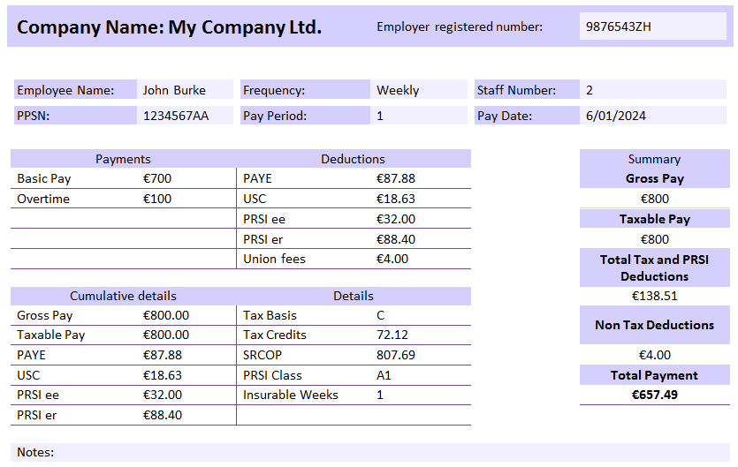
Reading a Payslip

Slide 18





Debate
Activity 2
Employees in Ireland should pay higher taxes on their pay
Prepare an argument for or against this motion from the perspective of the following groups of people.
Employers
Employees
The government

Slide 19

Learning Journal
Complete your Learning
Journal for
Unit 4 –
USC and PRSI For Employees.

