Slide 1
myAccount
Unit 5

Slide 2
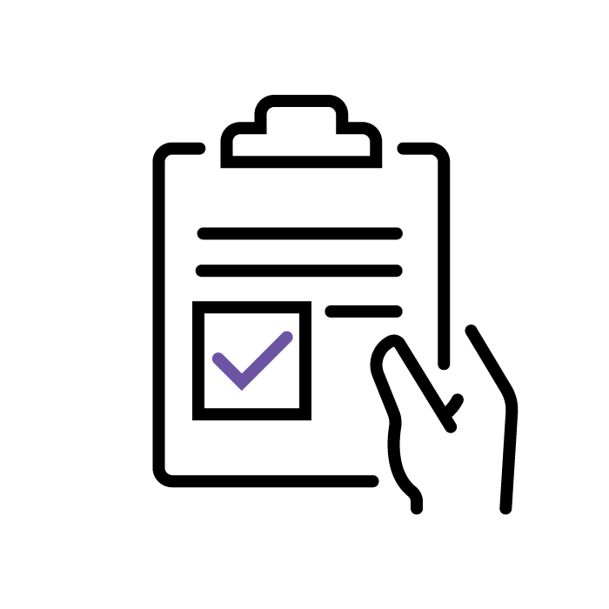
Learning Intentions
At the end of the unit, I will be able to:
1 | Register for myAccount
2 | Register my first job on myAccount
3 | Navigate the self-service options available on myAccount
4 | Complete a number of common tasks on myAccount

Slide 3
Unit 4 - Retrieval Practice
Activity 1
Who can answer the 10 questions correctly in the fastest time?
 | 1. What do the letters USC mean? | 2. USC is paid when total income exceeds what amount? | 3. What is the rate of USC charged on income above €70,044?
4. Name an income source on which USC is paid. | 5. Name an income source that is exempt from USC. | 6. What do the letters TCC mean? | 7. In what month does the Revenue Commissioners issue the TCC?
8. What do the letters PRSI mean? | 9. What do PRSI contributions fund? | 10. How many PRSI classes exist in Ireland?

Slide 4
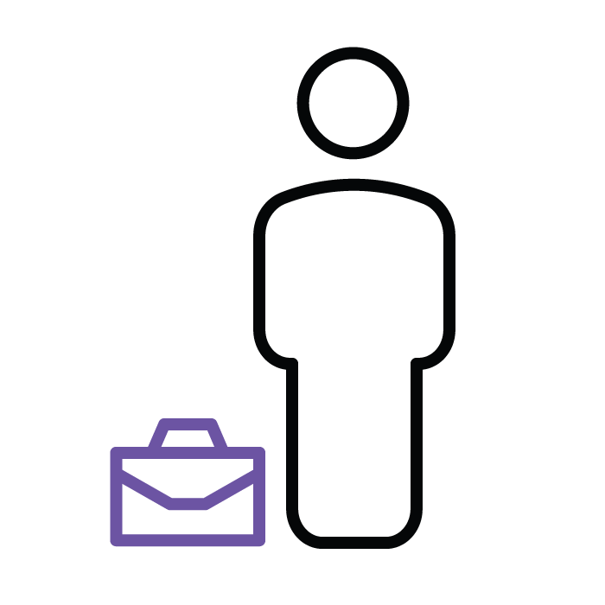
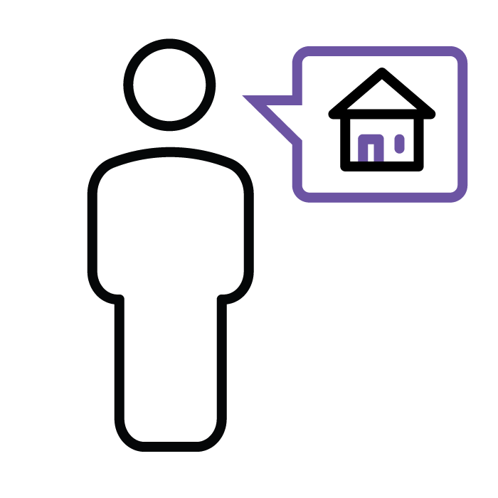
Registering for myAccount
The Revenue Commissioners provide a number of online platforms that are used by taxpayers to manage their tax affairs at a time and place that is convenient to their lives.
The myAccount platform is used by:
Individuals taxed under the PAYE system
Self-employed individuals
Individuals registered to pay Local Property Tax (LPT)

Slide 5
Registering for myAccount 2
Registering for myAccount
To register for myAccount, begin by selecting the myAccount link in the top right-hand corner of the Revenue website.

Slide 6
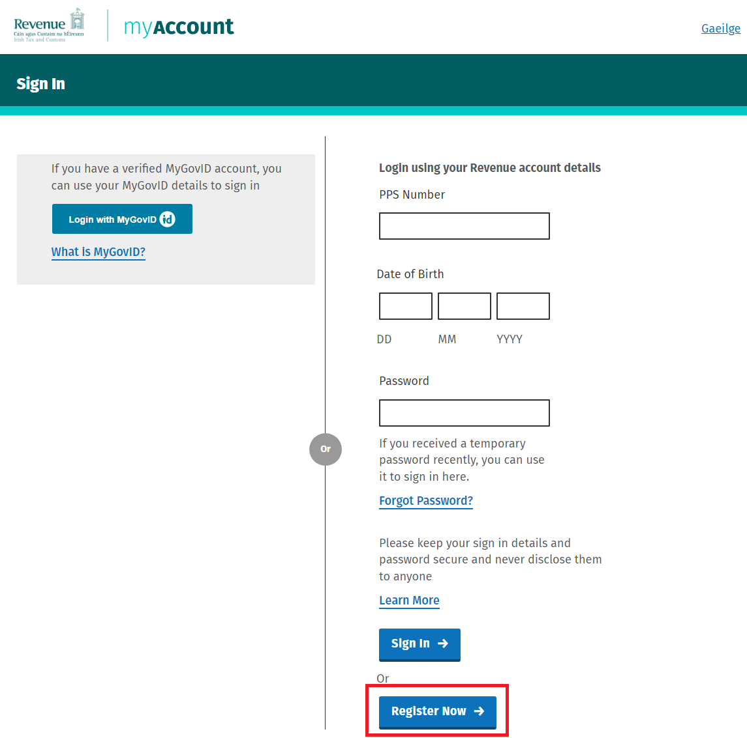
Registering for myAccount 3
Registering for myAccount
On the right-hand side of the screen, select the ‘Register Now’ button.
If you have a verified MyGovID account, you can sign into myAccount using your MyGovID details.

Slide 7
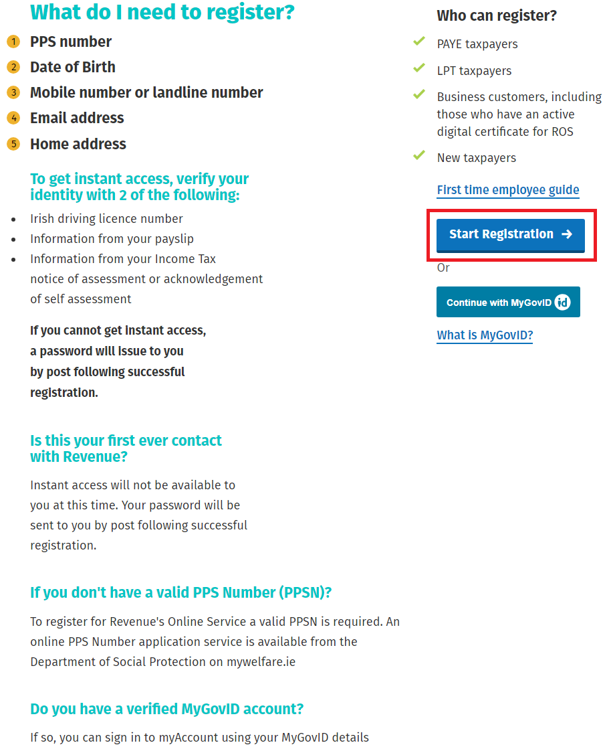
Registering for myAccount 4
Registering for myAccount
To register, you will need to enter the following details:
Personal Public Service Number (PPSN)*
Name
Date of birth
Address
Phone number
Email address.
*If born in Ireland, you receive a PPSN when your birth is registered.
*If born outside of Ireland, you must apply for a PPSN from the Department of Social Protection.

Slide 8
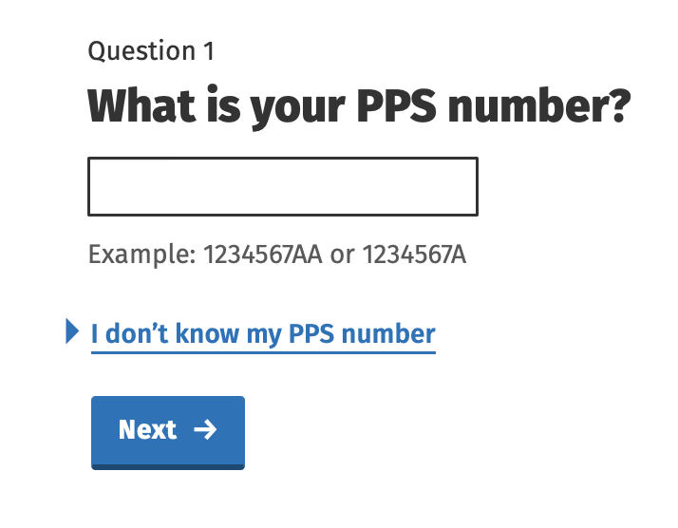
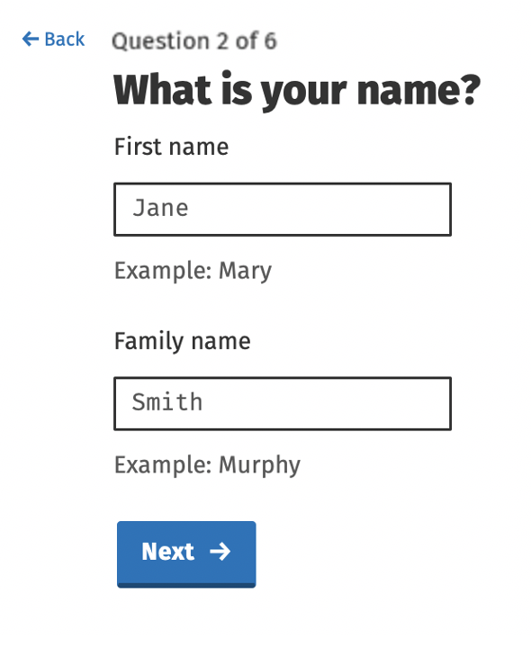
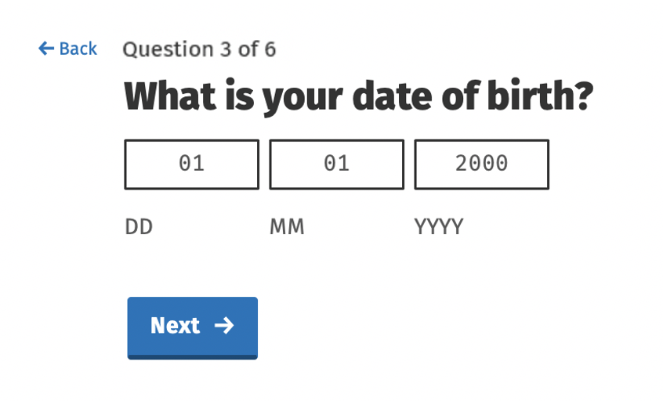
Registering for myAccount 5
Registering for myAccount

Slide 9
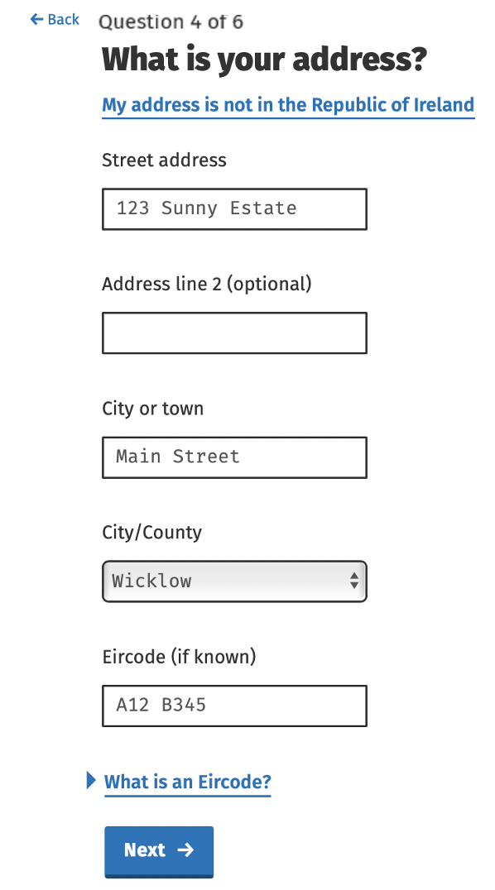
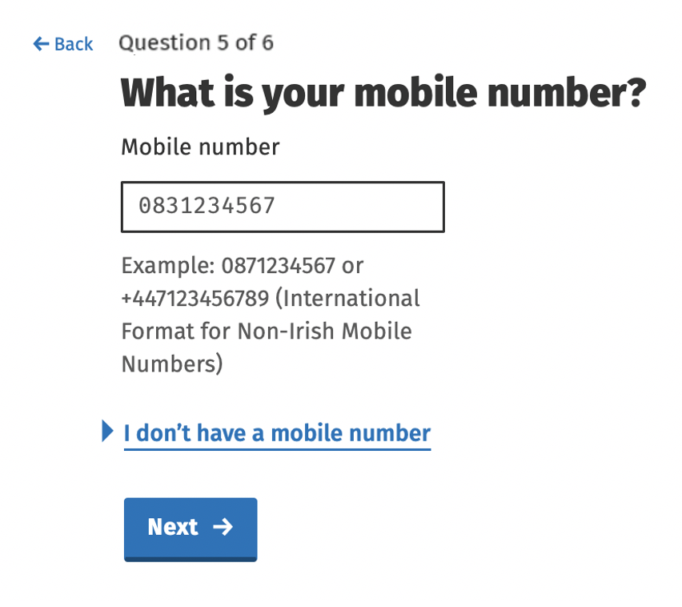
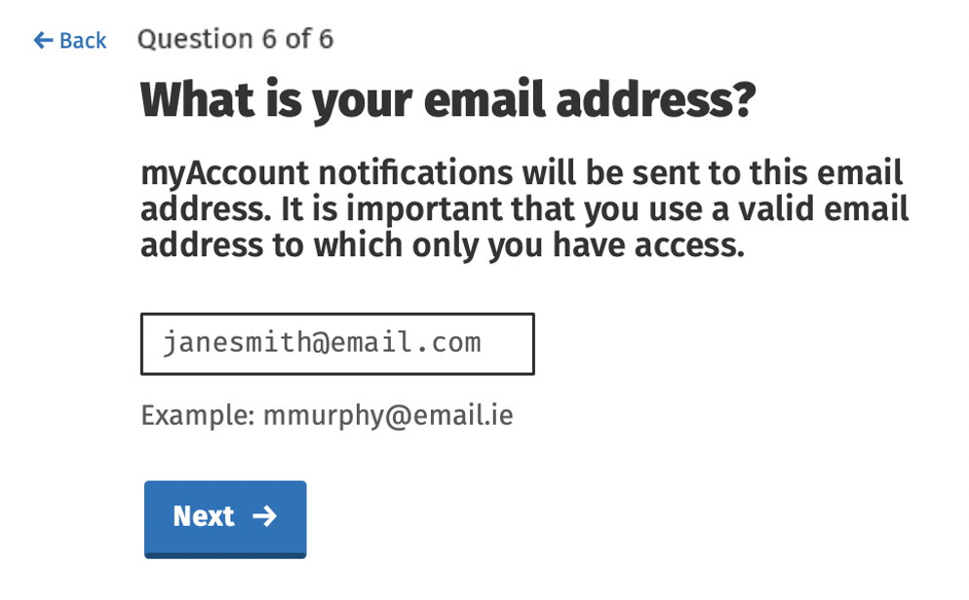
Registering for myAccount 6
Registering for myAccount

Slide 10
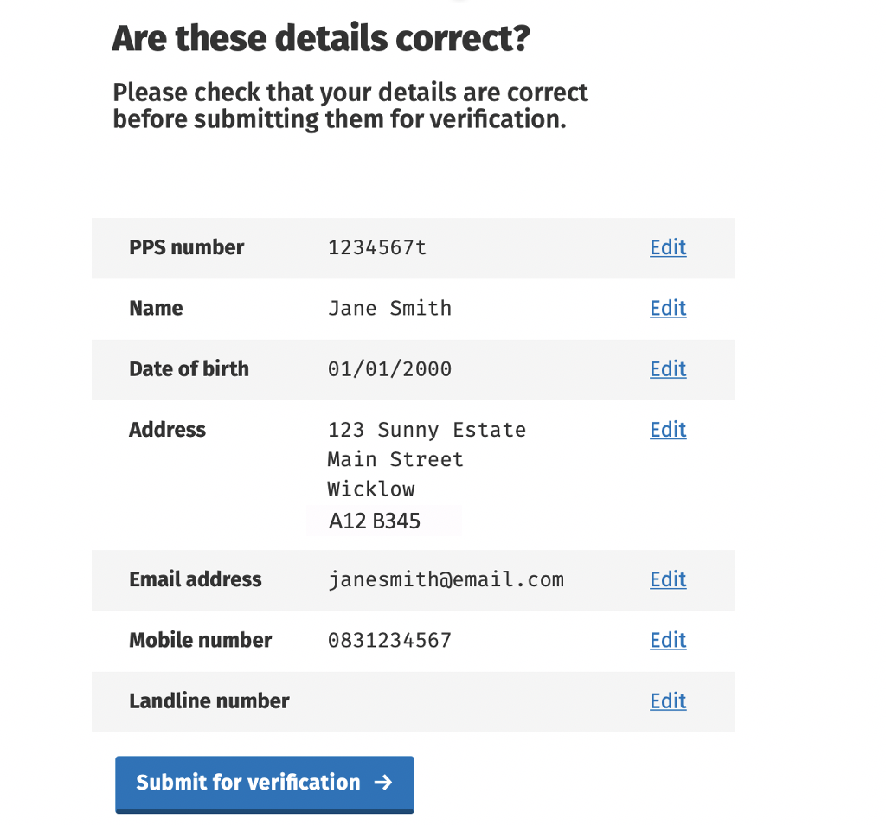
Registering for myAccount 7
Registering for myAccount
The final step allows you to review your details before submitting them to Revenue.

Slide 11
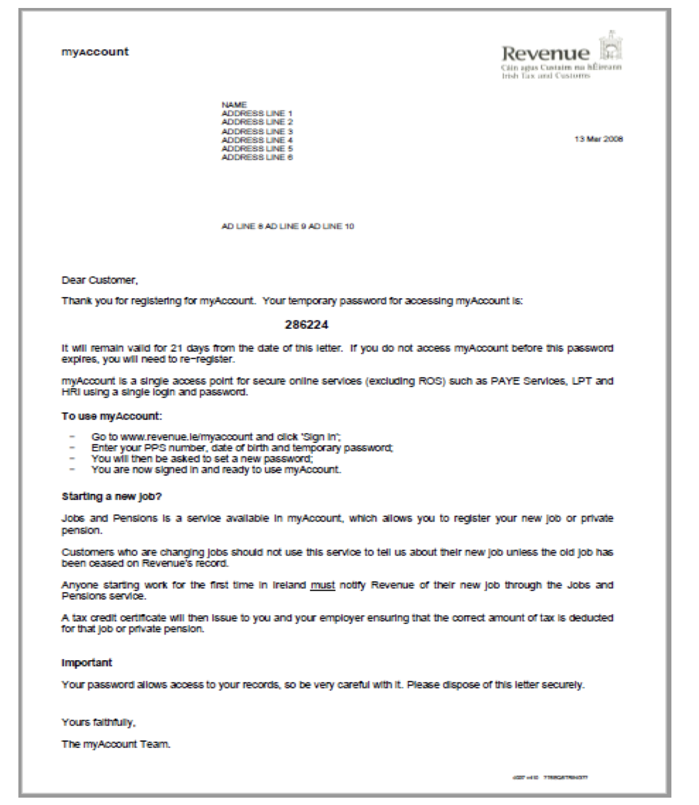
Registering for myAccount 8
Registering for myAccount
Revenue posts your temporary password to the address you have provided.
You must sign into myAccount within 21 days of the letter being sent to you.
If the password is not used within 21 days, it will expire, and you will need to register again.

Slide 12
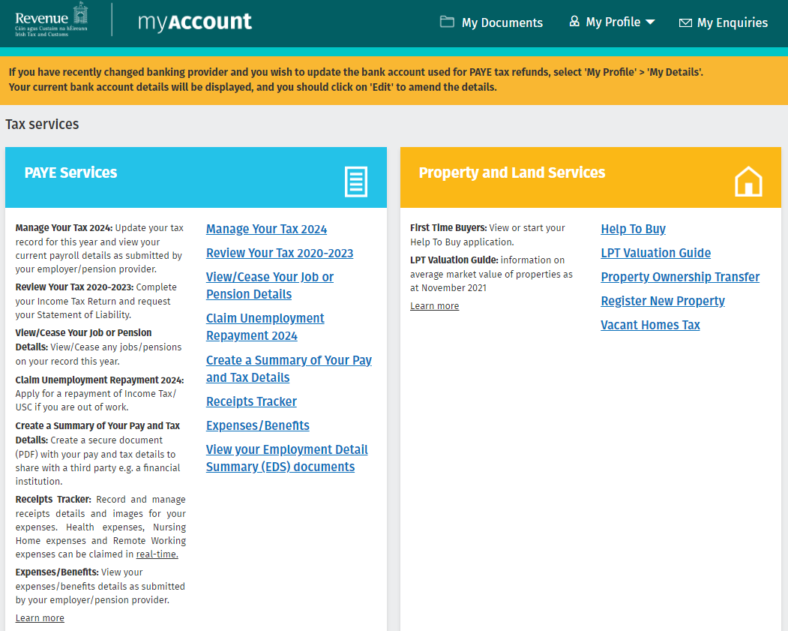
myAccount Services

Slide 13
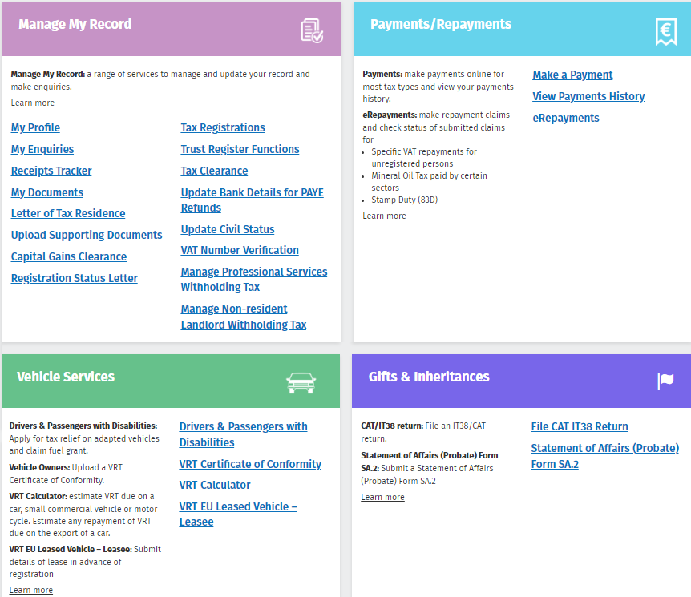
myAccount Services 2
myAccount Services

Slide 14
Registering For Your First Job
When you start working for the first time you must register your employment using myAccount.

Slide 15
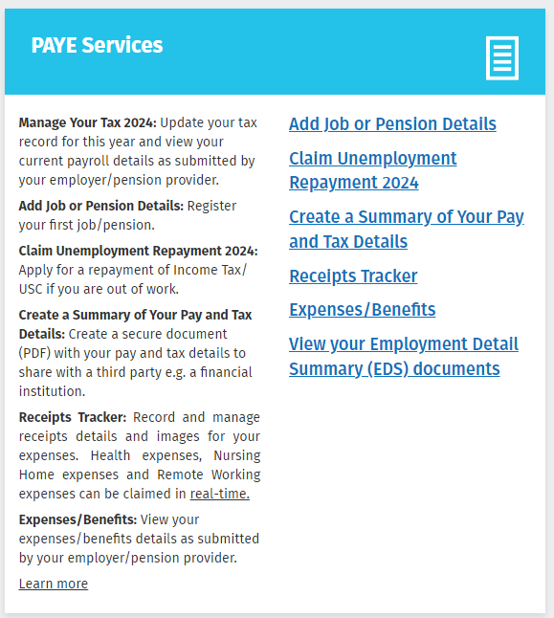
Registering For Your First Job 2
Registering For Your First Job
When you log onto myAccount for the first time, you will meet the placecard titled Jobs and Pensions.
After you have registered your job, this placecard will update to include options such as:
Manage Your Tax
Review Your Tax
Update Job or Pension Details.

Slide 16
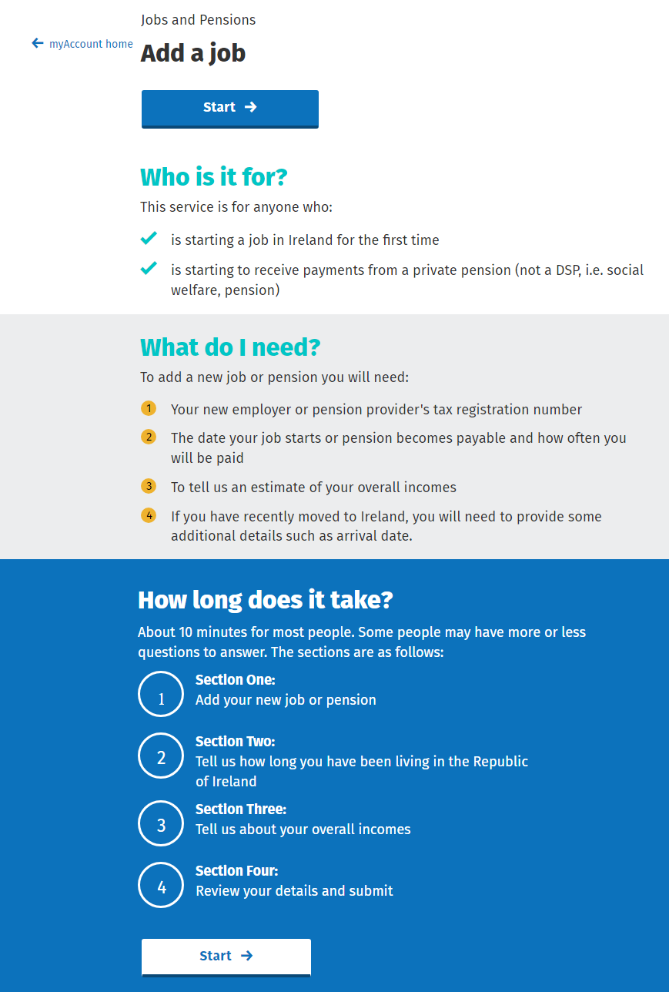
Registering For Your First Job 3
Registering For Your First Job
To register your job, you will need the following details:
your employer’s tax registration number
the date your job starts
how often you will be paid
an estimate of what your overall income will be
residency details, if you have recently moved to Ireland.

Slide 17
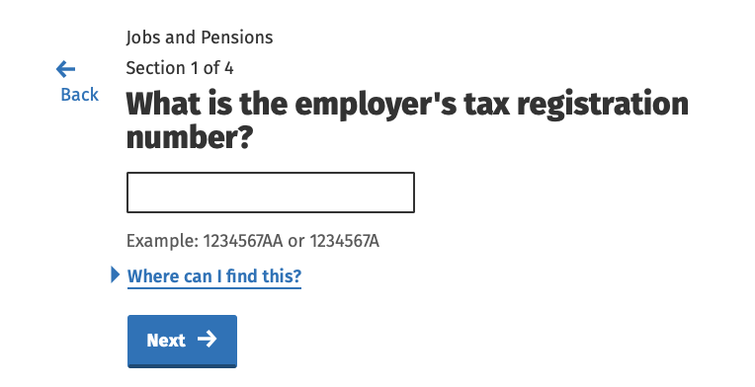
Registering For Your First Job 4
Registering For Your First Job
You will need to enter your employer’s tax registration number.
Your employer’s tax registration number consists of seven numbers, followed by one or two letters, e.g.
1234567A
1234567AA.

Slide 18
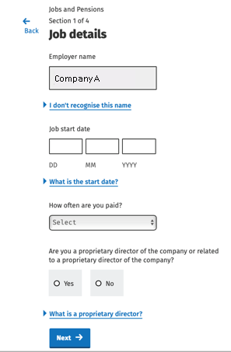
Registering For Your First Job 5
Registering For Your First Job
The company name will automatically appear, based on the tax registration number you entered on the previous screen.
The name on the screen may not match the company name that you know, as some companies will have a business name and a trading name.

Slide 19
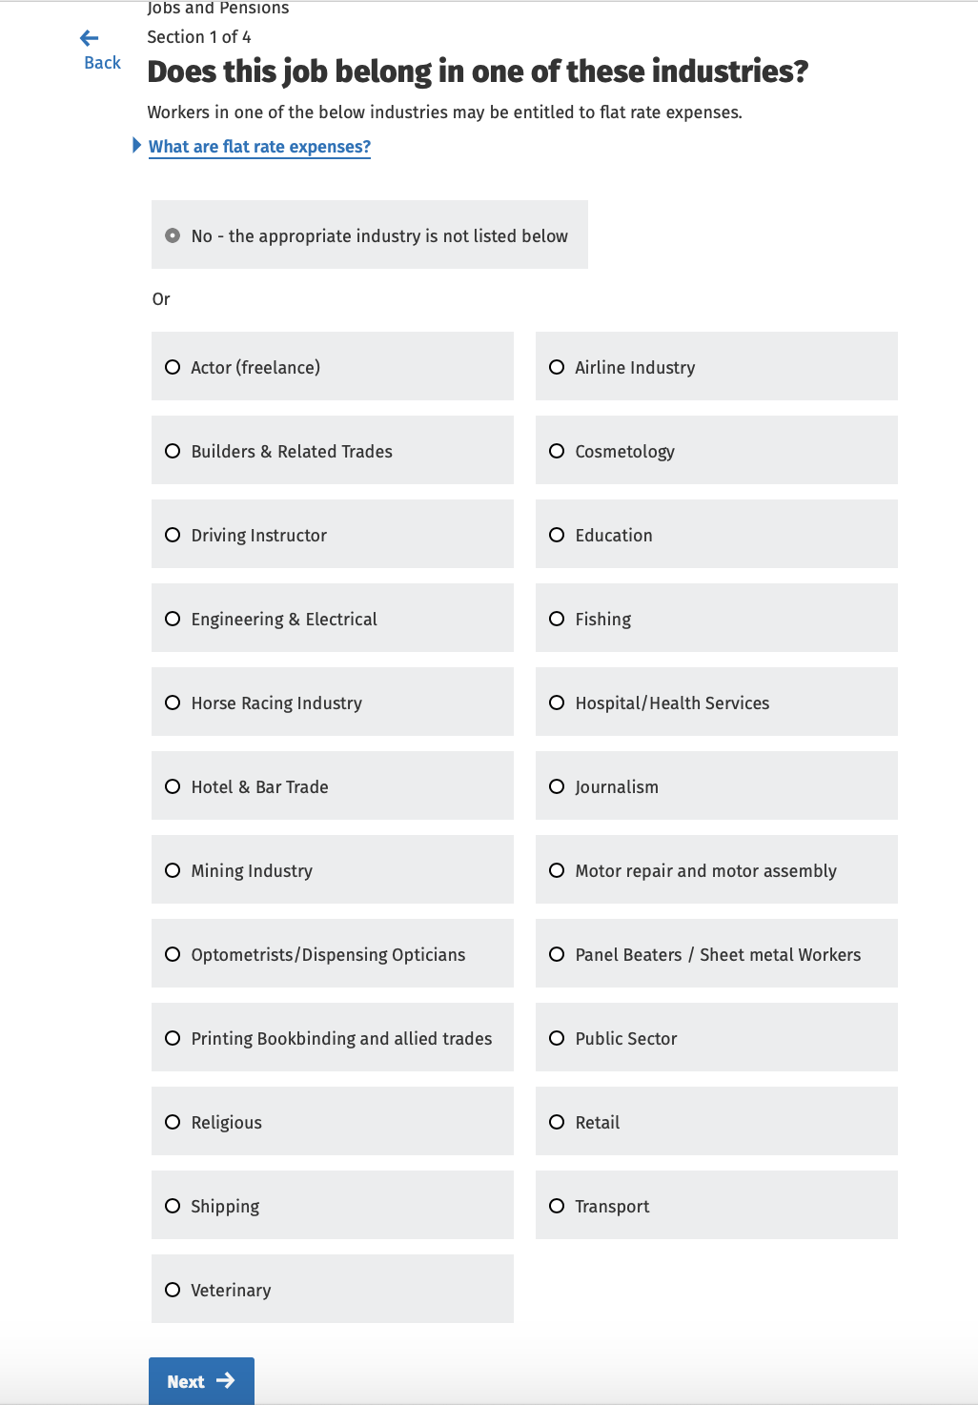
Registering For Your First Job 6
Registering For Your First Job
You will be asked to select the industry you are working in.
If none of the job industries match your job, simply choose the option at the top ‘No – the appropriate industry is not listed below’.

Slide 20
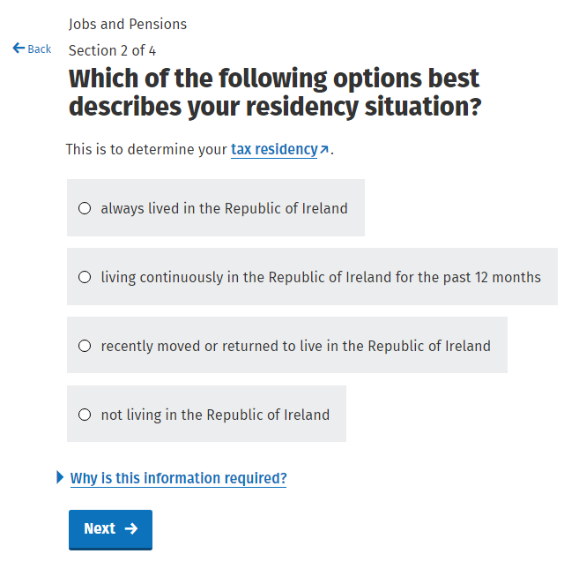
Registering For Your First Job 7
Registering For Your First Job
You will be asked to select
the option that best describes
your residency status.

Slide 21
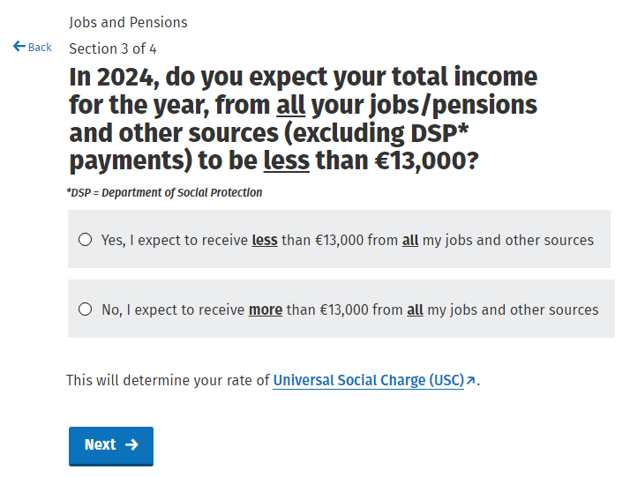
Registering For Your First Job 8
Registering For Your First Job
You will need to select whether your total income (excluding payments from Department of Social Protection) will be less than €13,000.
Based on previous lessons, do you know why this question is asked?

Slide 22
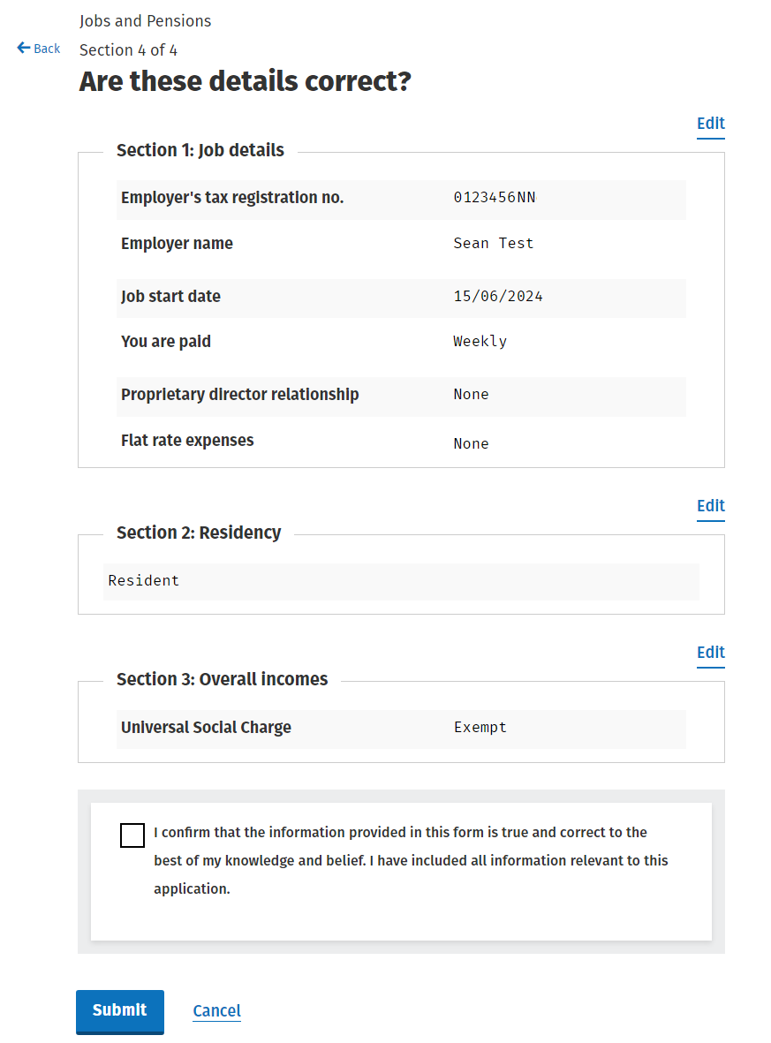
Registering For Your First Job 9
Registering For Your First Job

Slide 23
Registering For Your First Job 10
Registering For Your First Job
1. Revenue send instructions to your employer telling them how to tax you using a Revenue Payroll Notification (RPN).
3. You receive your payslip less any Income Tax, USC and PRSI.
2. Your employer takes the Income Tax, USC and PRSI from your wages and sends it to Revenue.

Slide 24
Video

Slide 25
Learning Journal
Complete your Learning
Journal for
Unit 5 –
myAccount

