Slide 1
Income Tax and Value Added Tax
Unit 6

Slide 2

Learning Intentions
At the end of the unit, I will be able to:
1 | Explain Income Tax related to Schedule D business income
2 | Differentiate between PAYE income and non-PAYE income
3 | Describe the criteria used to register for Income Tax
4 | Outline the responsibilities of a chargeable person
5 | Describe the features of Value Added Tax (VAT)
6 | Describe the different VAT rates imposed in Ireland
7 | Explain how a person/business registers for VAT and how VAT payments are made

Slide 3
Unit 5 - Retrieval Practice
Activity 1
Fill in the blanks in the following sentences.
To register your first job, you must register using Revenue’s online platform called m . You will need to include specific details, including:
the e registration number, an estimate of your overall
i and the d your job starts.
Once Revenue has these details it informs your employer how much tax
you must pay for Income Tax, U and PRSI using a Revenue P Notification. You will receive your pay less these d .
People who are self-e and individuals registered to pay Local
P Tax also register on this platform.

Slide 4





Recap: Income Tax
This is a direct tax levied by the Irish government on income earned
in Ireland and is collected through two different systems
PAYE System
collects taxes
Self-Assessment System collects taxes
Chargeable
Persons
Employees
People who receive
a work pension
People with
self-employed income
People with
non-PAYE income

Slide 5
Taxable Income
Business Income
Profits
Rental income
Employment Income
Salary, Wages, Pension
Certain Social Welfare Benefits
Jobseeker’s Benefit
Dividend Income
Share of company profits
Schedule D
Schedule F
Schedule E

Slide 6




Schedule D – Business Income
There are five different cases in Schedule D income
Case I: Income from a trade
Case II: Income from a profession
Case III: Untaxed interest and foreign income
Case IV: Taxed income and miscellaneous income
Case V: Rental income

Slide 7
Schedule D – Business Income 2
Schedule D – Business Income
Case | Explanation | Examples
Case I | Income from a trade | Plumber, carpenter
Case II | Income from a profession | Solicitor, accountant
Case III | Untaxed interest and foreign income | Foreign rental income
Case IV | Taxed income and miscellaneous income | Interest earned in an Irish bank account
Case V | Rental income | Rental income from Ireland

Slide 8
Schedule D – Business Income 3
Activity 2
Schedule D – Business Income
Match the case number with the correct explanation.
Case | Explanation
I | A Untaxed interest and foreign income
II | B Rental Income
III | C Income from a trade
IV | D Income from a profession
V | E Taxed income and miscellaneous income
Case I | Case II | Case III | Case IV | Case V

Slide 9

Income Information
What is PAYE
income?
What is
gross and net income?
What is
non-PAYE income?
9

Slide 10
Income Information 2
Income Information
PAYE Income
This is any source of income from employment and is described as Schedule E income –
Employment Income, e.g. wages, salary
Certain social welfare payments, e.g. jobseeker’s benefit
Dividend Income
A portion of a firm’s profits given to shareholders
Gross Income
Total income before deductions e.g. expenses, allowances, reliefs
Non-PAYE Income
This is any source of income outside of Schedule E – Employment Income, e.g. rental income, business profit
Net Income
Gross income less deductions

Slide 11

Gross Non-PAYE Income and Net Non-PAYE Income
I rent out my house and receive €20,000 per year (Gross non-PAYE income)
 | € | €
Rental Income |  | 20,000
Gross Non-PAYE Income |  | 20,000
Less Expenses
Repairs | 2,000
Insurance | +1,000 | -3,000
Net Non-PAYE Income |  | 17,000
I pay €2,000 to repair the house
I also pay €1,000 per year for house insurance on the property

Slide 12
Registering for Income Tax for Self-Assessment Purposes
Chargeable Person
Self-employed / sole-trader*
Individual registered on the PAYE system who also earns non-PAYE income†
  Gross non-PAYE income exceeds €30,000
  Net non-PAYE income exceeds €5,000
Non-PAYE income only, e.g. rental income
*This category can also include partnership business structures
†If a person does not meet either threshold, they must declare the non-PAYE income to Revenue via myAccount
Notes:
*This category can also include partnership business structures
†If a person does not meet either threshold, they must declare the non-PAYE income to Revenue via myAccount

Slide 13




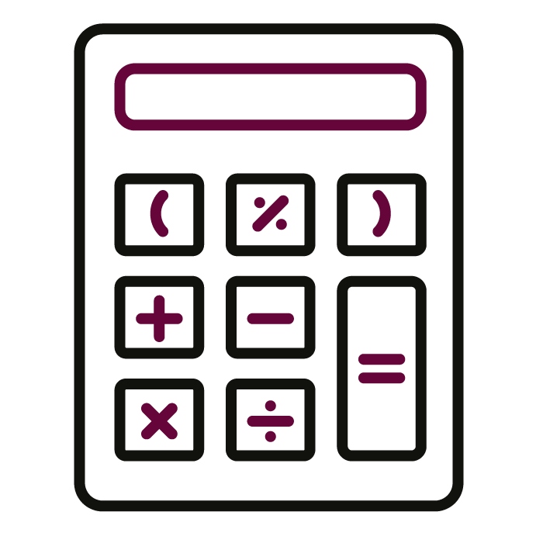

Responsibilities of a Chargeable Person
1. Register with Revenue Online Services (ROS)
4. ‘Pay and File’ – 31st October
Finalise the previous year’s tax liability by completing tax return Form 11
Pay the balance of tax liability owed from the previous year
2. Keep records of all purchases and sales
5. Pay Preliminary Tax* on / before 31st October
3. Calculate and pay any tax liability (Income Tax, USC and PRSI)
May pay a surcharge† on a late submission and / or interest for late payment of tax
Notes:
*Explained in detail on Lesson Plan 6, Section 10.0
† Explained in detail on Lesson Plan 6, Section 10.0

Slide 14
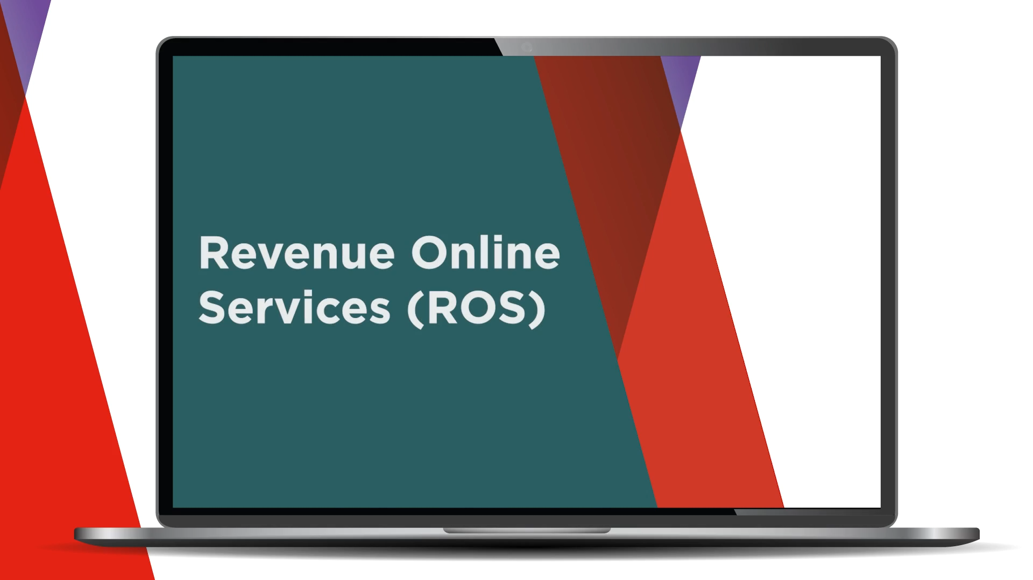
Video

Slide 15

Case Study 1
Paul Jones is a plumber and owns his own business called PJ Plumbing. This year he earned a net income of €35,000.
Is Paul required to register for Income Tax?
Yes, Paul needs to register for Income Tax, as he is self-employed

Slide 16

Case Study 2
Ella Thorne works full-time in a shop. She also rents out an apartment that she owns in Cork city centre.
In her first year of property letting, she has:
A gross Schedule D Case V rental income of €10,000
Expenses of €6,000
A net non-PAYE income of €4,000
Is Ella required to register for Income Tax?
Ella does not meet the threshold to be classified as a chargeable person
Her net non-PAYE income does not exceed €5,000
Her gross non-PAYE income does not exceed €30,000
She is not required to register for self-assessment Income Tax*
*As Ella does not meet either threshold, she must declare the non-PAYE income of €4,000 to Revenue via myAccount
Notes:
*As Ella does not meet either threshold, she must declare the non-PAYE income of €4,000 to Revenue via myAccount

Slide 17

Case Study 3
Edwin Sheen is the owner of a number of rental properties and last year earned a gross income of €31,000.
Is Edwin required to register for Income Tax?
Yes, Edwin needs to register for Income Tax

Slide 18
Income Tax Revision
Activity 3
 | Statement | True / False
1 | Income from self-employed individuals is collected through the PAYE system
2 | Gross Income + Expenses = Net Income
3 | The Pay and File deadline is 31st October
4 | Schedule D relates to business income
5 | Rental income is an example of PAYE income for an individual

Slide 19
Value Added Tax

Slide 20
Goods and Services
Activity 4
Definitions
Goods
Services
Examples
Examples

Slide 21
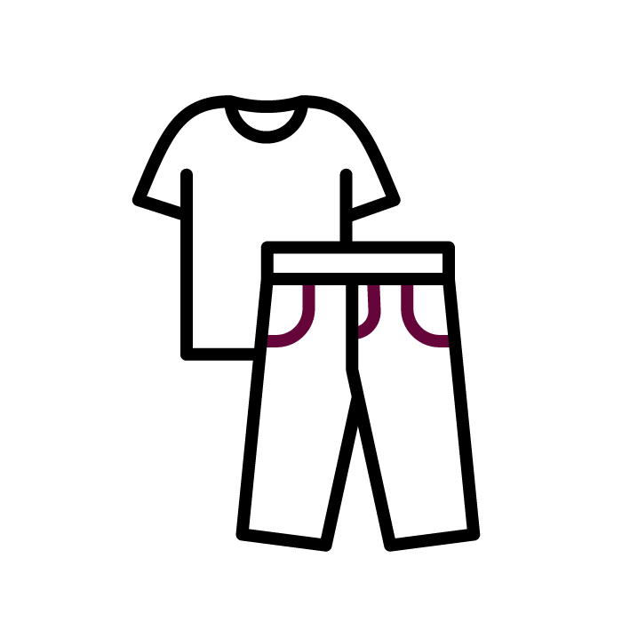




Goods and Services 2
Goods and Services
Goods are physical objects
Services are work done for others
Hairdresser
Clothes
Mechanic
Food and Drinks
Solicitor
Smart Phones

Slide 22
VAT
What do the letters VAT mean?
What is VAT imposed on?
Who pays VAT?
Who is responsible for collecting VAT?
What is the standard VAT rate?
Name an item that is VAT exempt.

Slide 23
Value Added Tax (VAT)
This is an indirect tax that is paid when you buy goods and services
  VAT is included in the price of the good / service
It is a tax that is imposed in all European Union member states but the rates differ across the countries
In Ireland, VAT is collected by businesses that sell goods and services and is then paid to the Revenue Commissioners
A percentage of all VAT collected by every EU country is used to fund the EU’s budget

Slide 24














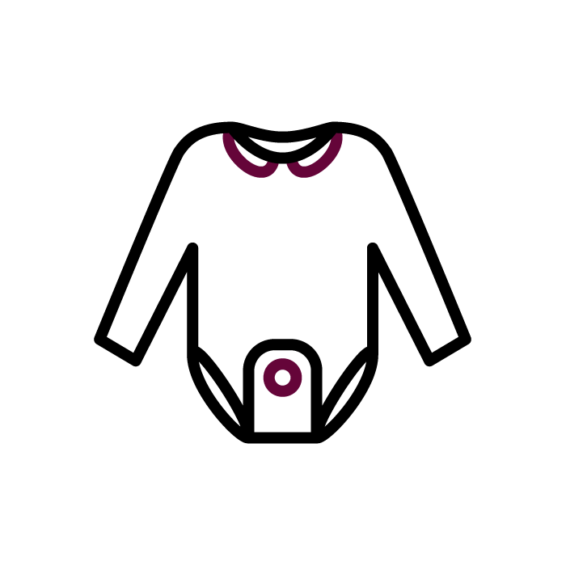
VAT Rates
There are several different VAT rates* imposed on goods and services in Ireland including:
Standard Rate
23%
Reduced Rate
13.5%
Second Reduced Rate 9%
Zero Rate
0%
Batteries
Photography
Newspaper
Wheelchairs
Furniture
Driving Lessons
Bowling
Fruit
Motor vehicles
Vet fees
Horse Riding
Bread
Cleaning and
maintenance
Gym Membership
Children's clothing
Adult clothing
Livestock rate – 4.8%
Flat rate compensation for farmers – 4.8%

Slide 25





VAT Exempt Goods and Services
There are certain goods and services which are VAT exempt, including:
Financial Services
Educational Services
Medical Services
Banking Services
Insurance Services
Passenger Transport

Slide 26
VAT Database
Activity 5
Using the VAT Rate Database, find the VAT rates applicable to the following goods and services. Choose two additional goods/services and record the VAT rates that apply.
 | Good / Service | VAT Rate
1 | Architect fees
2 | Funeral undertaker
3 | Rings (jewellery)
4 | Eggs
5 | Paintball
6 | Handbags
7 | Take-away (cooked meals)
8 | Video games
9
10

Slide 27
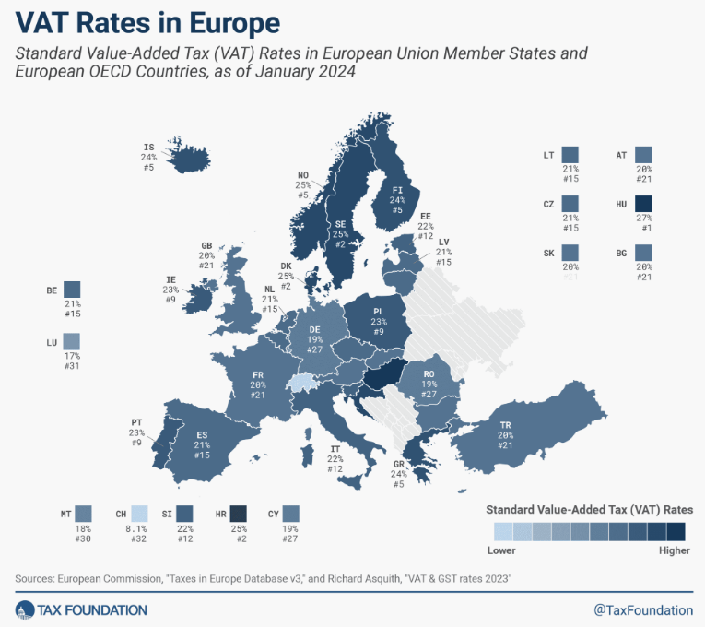
Activity 6
4. What countries have the abbreviations?
(i) BE, (ii) IT, (iii) PT?
1. What EU country imposes the highest VAT rate?
2. What EU country imposes the lowest VAT rate?
5. What is the standard VAT rate in (i) Germany
and (ii) Finland?
3. What is the standard VAT rate in Ireland?
6. How many countries are in the European Union?

Slide 28


Registering for Value Added Tax
All businesses providing ‘accountable’ goods or services can register and account for VAT
I own a website design business and this year had sales of €45,000. Do I need to register for VAT?
Businesses that exceed the following sales threshold must register and account for VAT:
Goods threshold: €75,000
Services threshold: €37,500
Businesses can register using Revenue’s e-registration services on ROS

Slide 29
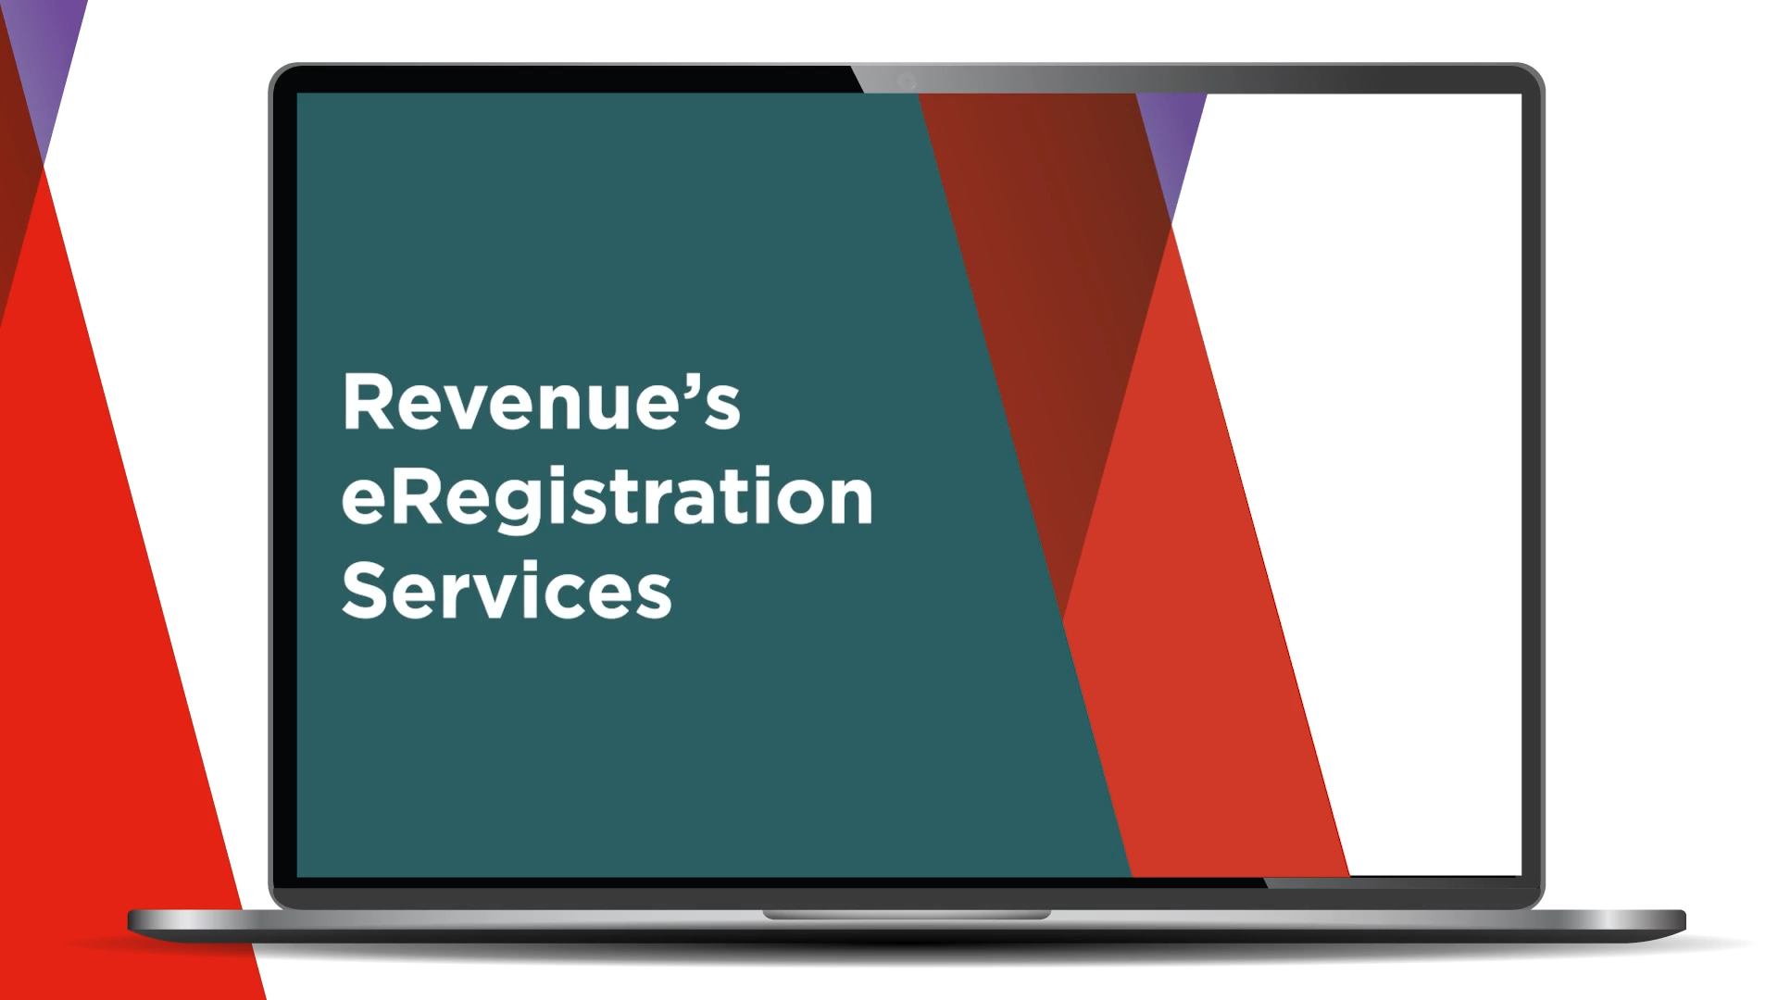
Video 2

Slide 30
VAT Registered Businesses
Revenue Commissioners
VAT received = €46
€23 VAT is sent to
Sells a TV for €100+23% VAT €123
€23 VAT is sent to
Sells a TV for
€200+23% VAT €246
Manufacturer
Retailer
Consumer
€100 kept by
the manufacturer
Pays €123
for the TV
Pays €246
for the TV
VAT is usually paid bi-monthly and filed with a VAT3 form
VAT is paid by using: ROS
myAccount
€46 VAT collected
Keeps €23*
€23 VAT sent to the Revenue Commissioners
Notes:
€23 is reclaimed from the €23 already paid to the manufacturer

Slide 31

Learning Journal
Complete your Learning Journal for Unit 6 – Income Tax and VAT

